Slide 1

Digital Portfolio
STUDENT NAME: k. Soniya
REGISTER NO AND NMID: 30330324u18113,
9DC019107735856A4074AC6414576862
DEPARTMENT: BSc. Computer Science
COLLEGE: Arcot sri mahaalakshmi women’s College
Thiruvallur University
1
Notes:
1

Slide 2

PROJECT TITLE
Portfolio using HTML, CSS, and JavaScript”
2

Slide 3




AGENDA
Problem Statement
Project Overview
End Users
Tools and Technologies
Portfolio design and Layout
Features and Functionality
Results and Screenshots
Conclusion
Github Link
3/21/2024 Annual Review
3

Slide 4

PROBLEM STATEMENT
Many students and professionals need a platform to showcase their skills, projects, and achievements effectively. Creating a digital portfolio using HTML, CSS, and JavaScript provides a structured, interactive, and visually appealing way to present personal and professional information online, making it accessible and engaging across devices.
4

Slide 5

PROJECT OVERVIEW
Personal Portfolio Website
This project is a digital portfolio created using HTML, CSS, and JavaScript. It showcases personal details, education, skills, hobbies, and projects in a visually appealing and interactive way. Features include smooth navigation, responsive design, and dynamic elements like form validation and hover effects. The portfolio enhances personal branding and provides a professional online presence.
5

Slide 6

WHO ARE THE END USERS?
The end users of a portfolio created with HTML, CSS, and JavaScript include employers and recruiters who want to evaluate your skills and projects, clients looking to assess your work for potential projects, peers or colleagues seeking inspiration or collaboration, and general visitors interested in learning about your work and achievements.
6

Slide 7

TOOLS AND TECHNIQUES
Tools:
Code Editors: VS Code, Sublime Text, Brackets
Browsers & Dev Tools: Chrome, Firefox, Edge
Techniques:
HTML: Use semantic tags, lists, forms, and media elements.
CSS: Flexbox/Grid for layout, animations, transitions, responsive design.
JavaScript: Interactive elements, form validation, sliders, dynamic content.
7

Slide 8
POTFOLIO DESIGN AND LAYOUT
The portfolio provides a clean and professional digital presence using HTML, CSS, and JavaScript. It includes sections like About, Skills, Projects, and Contact, with interactive elements and animations for an engaging user experience. The design effectively showcases personal information, technical skills, and completed projects in a polished, user-friendly layout.
8

Slide 9
FEATURES AND FUNCTIONALITY
A portfolio using HTML, CSS, and JavaScript is interactive and visually appealing. It includes sections like Home, About, Skills, Projects, and Contact, with smooth navigation and responsive design. Skills and projects can be showcased with animations, progress bars, or interactive cards. JavaScript adds dynamic effects like modals, tooltips, and form validation, making the portfolio engaging and professional.

Slide 10
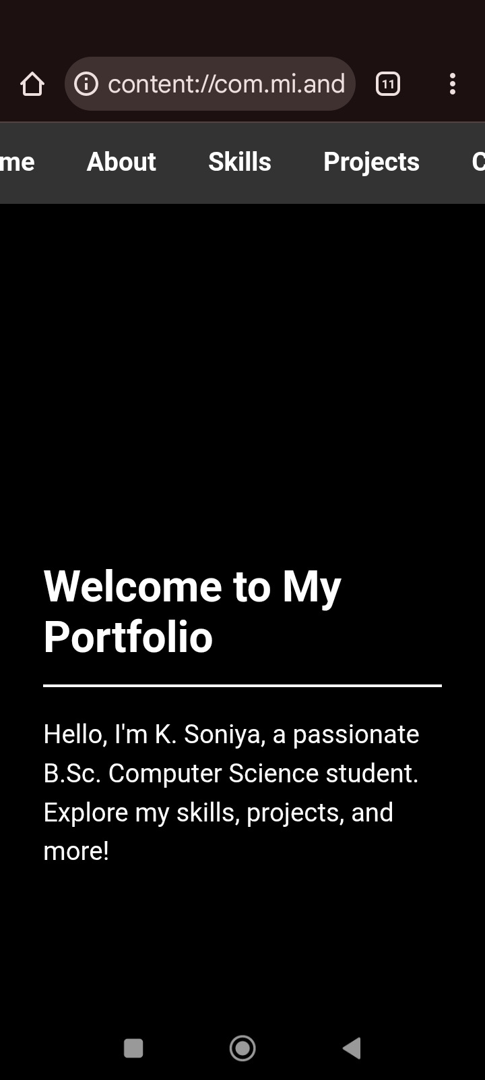

RESULTS AND SCREENSHOTS
Welcome to My PortfolioHello, I’m K. Soniya, a
passionate B.Sc. Computer Science student at
Arcot Sri Mahalakshmi
Women’s College.
I’m dedicated to learning technology and
applying my skills in creative ways. This portfolio showcases my ed
ucation, skills, projects, and interests. Explore to learn more about me!
3/21/2024 Annual Review
10

Slide 11
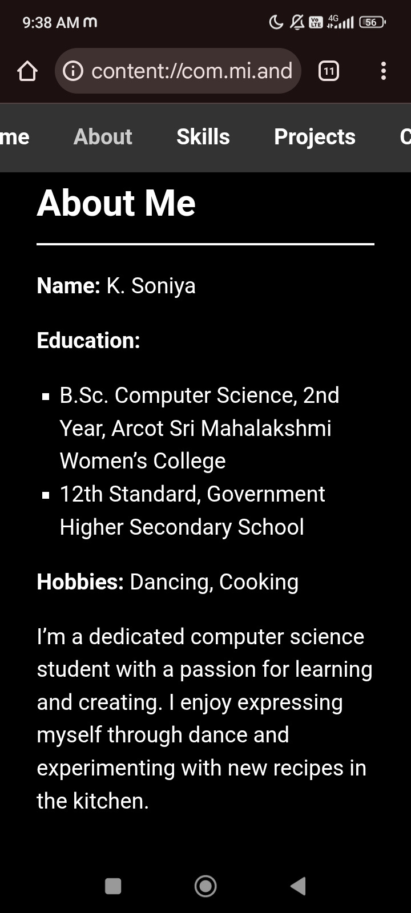
SCREENSHOTS 2
About MeName: K. Soniya
Education:B.Sc. Computer Science, 2nd Year, Arcot Sri Mahalakshmi Women’s College12th Standard, Government Higher Secondary School
Hobbies: Dancing, Cooking
About: I’m a committed computer science student with a strong interest in programming and problem-solving. Outside academics, I express myself through dance, enjoying various styles, and love cooking, where I experiment with new recipes, especially South Indian dishes. My passion for learning drives me to grow both technically and personally.
3/21/2024 Annual Review
10

Slide 12
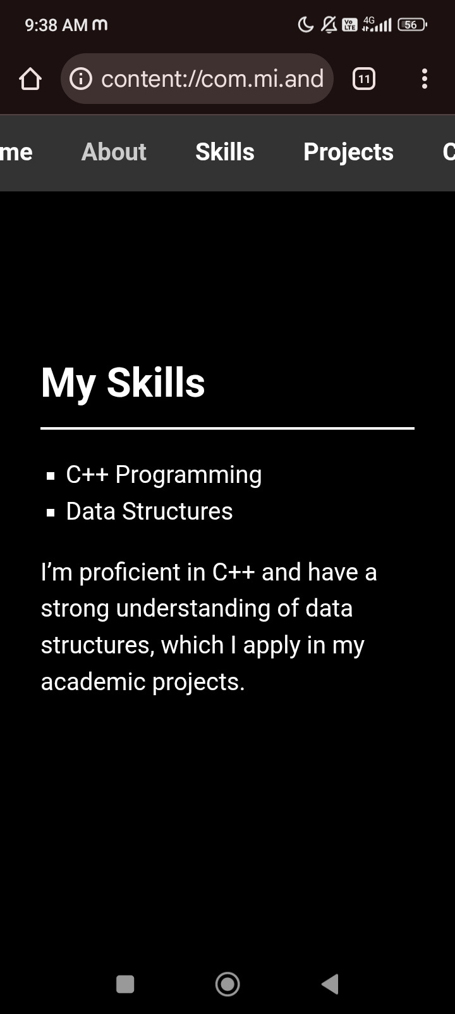
SCREENSHOTS 3
My SkillsI have developed proficiency in the following areas:C++ Programming: Skilled in writing efficient code for various applications.Data Structures: Strong understanding of arrays, linked lists, and other structures used in my projects.
I actively apply these skills in academic assignments and personal projects, building a solid foundation in computer science.
3/21/2024 Annual Review
10

Slide 13
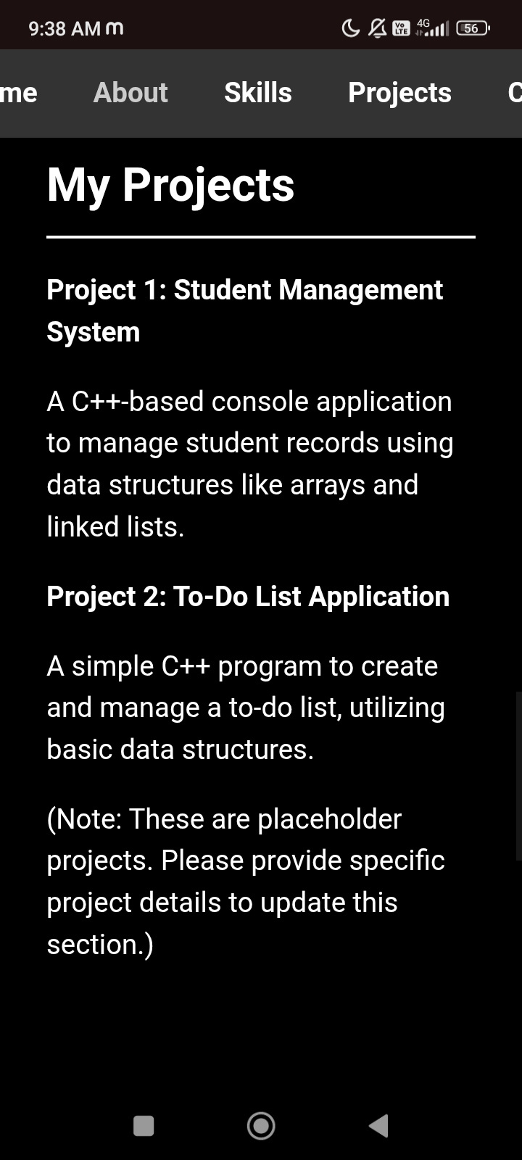
SCREENSHOTS 4
My ProjectsBelow are examples of my work (Note: These are placeholders; specific project details can be added):
Project 1: Student Management System
A C++-based console application to manage student records. It uses data structures like arrays and linked lists to store and retrieve information efficiently. This project helped me strengthen my coding and organizational skills.Project 2: To-Do List Application
A simple C++ program that allows users to create and manage a to-do list. It utilizes basic data structures for task storage and retrieval, showcasing my ability to build practical tools.
3/21/2024 Annual Review
10

Slide 14
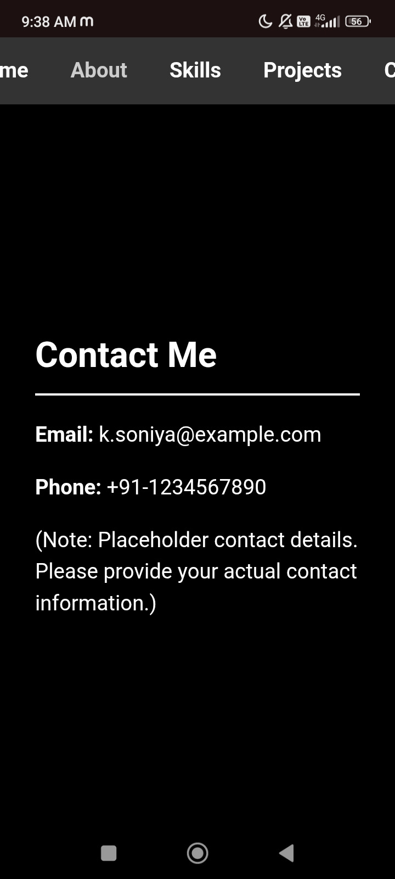
SCREENSHOTS 5
Contact MeEmail: k.soniya@example.com
Phone: +91-1234567890
I’d love to connect and discuss opportunities or collaborations. Feel free to reach out!
Note: These are placeholder contact details. Please provide actual email and phone information to update this section.
3/21/2024 Annual Review
10

Slide 15
CONCLUSION
This portfolio demonstrates a comprehensive application of HTML, CSS, and JavaScript to create a visually appealing and interactive digital presence. HTML structures the content effectively, CSS enhances the design with colors, layouts, and responsiveness, while JavaScript adds dynamic features and interactivity. The project showcases personal skills, projects, and achievements in a professional manner. Overall, it serves as an effective tool for self-presentation and highlights the practical integration of front-end web technologies.
11

Slide 16
GitHub link
https://github.com/soniyak0701-cyber/Soniya-k.git

